Slide 1
CS 2009
Design and Analysis of Algorithms
The Maximum Subarray Problem

Slide 2
The Maximum Subarray Problem
Def: The maximum subarray problem is the task of finding the largest possible sum of a contiguous subarray, within a given one-dimensional array A[1…n] of numbers.
1 | 2 | 3 | 4 | 5 | 6 | 7 | 8 | 9 | 10 | 11 | 12 | 13 | 14 | 15 | 16
13 | -3 | -25 | 20 | -3 | -16 | -23 | 18 | 20 | -7 | 12 | -5 | -22 | 15 | -4 | 7

Slide 3
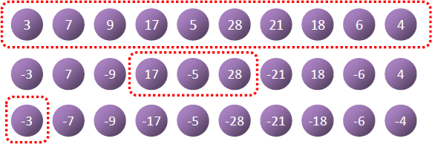
The Maximum Subarray Problem

Slide 4
Divide-and-Conquer
Base Case (n = 1)
Return itself (maximum subarray)
Recursive Case (n > 1)
Divide array into two subarrays.
Find maximum sub array recursively
Merge the results.

Slide 5
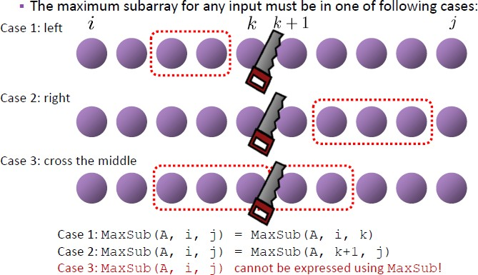
Where is Result?

Slide 6
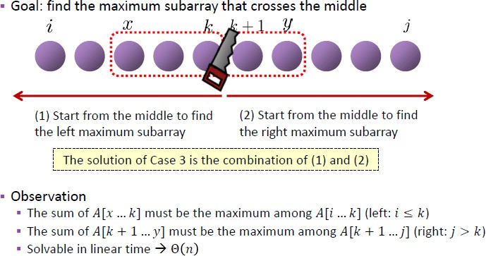
Case 3: Cross the Middle

Slide 7
The Maximum Subarray Problem - Example
-2 | -5 | 6 | -2 | 3 | 1 | 5 | -6
What is maximum subarray sum of this array
Maximum subarray sum is 6-2+3+1+5 = 13

Slide 8




MaxSubArray: RECURSIVE CALLS
-2 | -5 | 6 | -2 | 3 | 1 | 5 | -6
Recurse!
Recurse!
-2 | -5 | 6 | -2
3 | 1 | 5 | -6
Recurse!
Recurse!
Recurse!
Recurse!
-2
-5
6
-2
3
1
5
-6
Recurse!
Recurse!
Recurse!
Recurse!
This is where we hit our base case! 9
-2
-5
6
-2
3
1
5
-6

Slide 9
MaxSubArray Example 1
Max (6,9,13)
MSS= 13
-2 | -5 | 6 | -2 | 3 | 1 | 5 | -6
Max (4,5,9)
MSS= 9
Max (-2,6,1)
MSS= 6
-2 | -5 | 6 | -2
3 | 1 | 5 | -6
Max (6,-2,4)
MSS= 6
Max (5,-6,-1)
MSS= 5
Max (-2,-5,-7)
MSS= -2
-2
-5
6
-2
3
1
5
-6
-2
-5
6
-2
3
1
5
-6
11

Slide 10
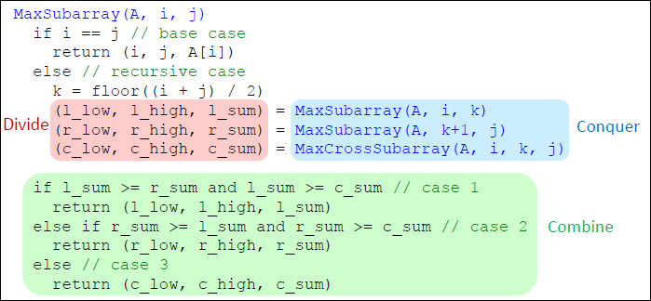
Divide and Conquer Solution

Slide 11
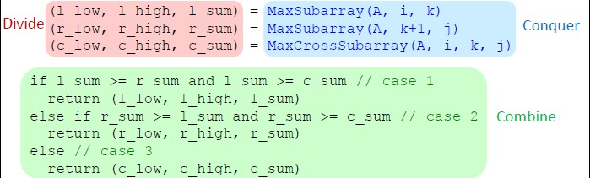
Divide and Conquer Solution
Max (4,5,9)
MSS= 9
Max (-2,6,1)
MSS= 6
-2 | -5 | 6 | -2
3 | 1 | 5 | -6
Max (6,-2,4)
MSS= 6
Max (5,-6,-1)
MSS= 5
Max (-2,-5,-7)
MSS= -2
-2
-5
6
-2
3
1
5
-6

Slide 12
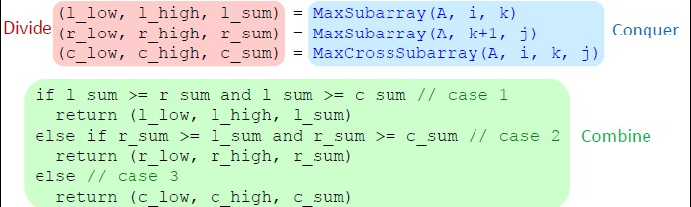
Divide and Conquer Solution
Max (6,9,13)
MSS= 13
-2 | -5 | 6 | -2 | 3 | 1 | 5 | -6
Max (4,5,9)
MSS= 9
Max (-2,6,1)
MSS= 6
-2 | -5 | 6 | -2
3 | 1 | 5 | -6

Slide 13
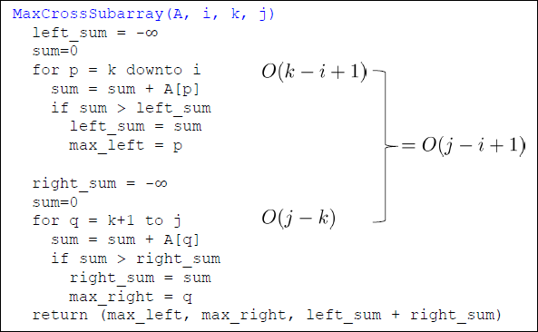
Divide and Conquer Solution

Slide 14
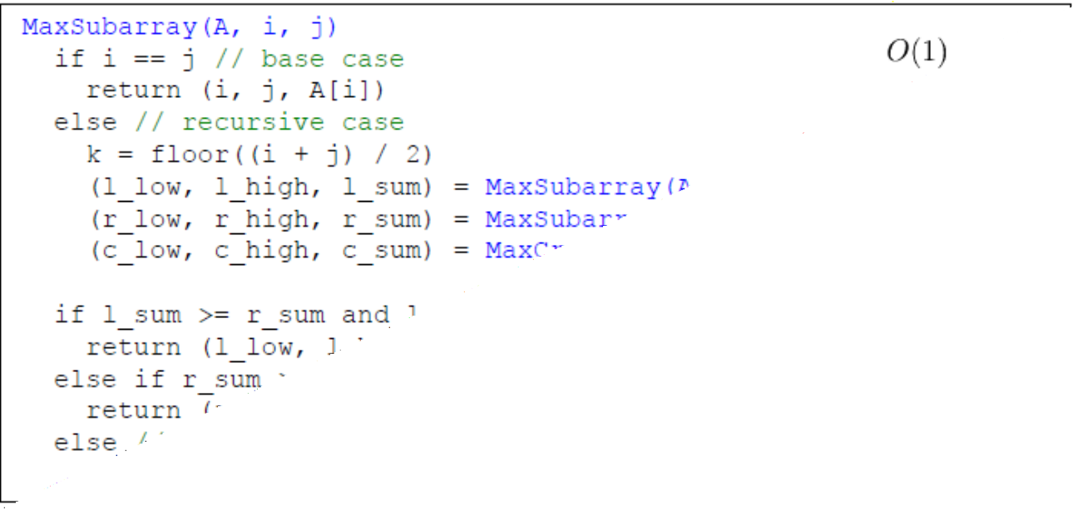
Divide and Conquer Solution

Slide 15
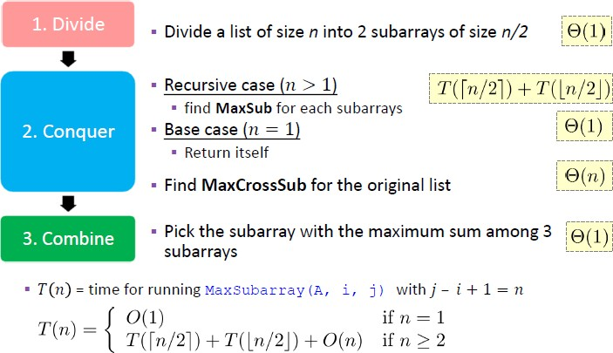
Divide and Conquer Solution

Slide 16
MaxSubArray Example 2
Max (8,6,11)
MSS= 11
-2 | -5 | 6 | 2 | -3 | 1 | 5 | -6
Max (1,5,6)
MSS= 6
Max (-2,8,1)
MSS= 8
-2 | -5 | 6 | 2
-3 | 1 | 5 | -6
Max (6,2,8)
MSS= 8
Max (-3,1,-2)
MSS= 1
Max (5,-6,-1)
MSS= 5
Max (-2,-5,-7)
MSS= -2
-2
-5
6
2
-3
1
5
-6
-2
-5
6
2
-3
1
5
-6
11

Slide 17
MaxSubArray Example 3
Max (8,9,17)
MSS= 17
-2 | -5 | 6 | 2 | 3 | 1 | 5 | -6
Max (4,5,9)
MSS= 9
Max (-2,8,1)
MSS= 8
-2 | -5 | 6 | 2
3 | 1 | 5 | -6
Max (6,2,8)
MSS= 8
Max (3,1,4)
MSS= 4
Max (5,-6,-1)
MSS= 5
Max (-2,-5,-7)
MSS= -2
-2
-5
6
2
3
1
5
-6
-2
-5
6
2
3
1
5
-6
11

Slide 18
MaxSubArray Example 4
Max (6,6,7)
MSS= 7
-2 | -5 | 6 | -2 | -3 | 1 | 5 | -6
Max (1,5,6)
MSS= 6
Max (-2,6,1)
MSS= 6
-2 | -5 | 6 | -2
-3 | 1 | 5 | -6
Max (6,-2,4)
MSS= 6
Max (-3,1,-2)
MSS= 1
Max (5,-6,-1)
MSS= 5
Max (-2,-5,-7)
MSS= -2
-2
-5
6
-2
-3
1
5
-6
-2
-5
6
-2
-3
1
5
-6
11

